Slide 1

Data Structures
Topic: Merge Sort
By
Ravi Kant Sahu
Asst. Professor
Lovely Professional University, Punjab

Slide 2
Divide and Conquer
Recursive in structure
  Divide the problem into sub-problems that are similar to the original but smaller in size
  Conquer the sub-problems by solving them recursively. If they are small enough, just solve them in a straightforward manner.
  Combine the solutions to create a solution to the original problem
Ravi Kant Sahu, Asst. Professor @ Lovely Professional University, Punjab (India)

Slide 3
An Example: Merge Sort
Sorting Problem: Sort a sequence of n elements into non-decreasing order.
Divide: Divide the n-element sequence to be sorted into two subsequences of n/2 elements each
Conquer: Sort the two subsequences recursively using merge sort.
Combine: Merge the two sorted subsequences to produce the sorted answer.
Ravi Kant Sahu, Asst. Professor @ Lovely Professional University, Punjab (India)

Slide 4
Merge Sort – Example
18
26
32
6
43
15
9
1
22
26
19
55
37
43
99
2
18
26
32
6
43
15
9
1
22
26
19
55
37
43
99
2
18
26
32
6
43
15
9
1
22
26
19
55
37
43
99
2
18
26
32
6
43
15
9
1
22
26
19
55
37
43
99
2
18
26
32
6
43
15
9
1
22
26
19
55
37
43
99
2
Ravi Kant Sahu, Asst. Professor @ Lovely Professional University, Punjab (India)

Slide 5
Merge Sort – Example
Original Sequence
Sorted Sequence
18
26
32
6
43
15
9
1
18
26
32
6
43
15
9
1
1
6
9
15
18
26
32
43
18
26
32
6
43
15
9
1
18
26
32
6
43
15
9
1
6
26
32
6
18
26
32
18
1
9
15
43
1
9
15
43
18
26
43
15
9
1
18
26
32
6
43
15
9
1
32
6
18
26
6
32
15
43
18
26
6
32
15
43
1
9
1
9
18
26
32
15
1
15
18
26
32
6
43
15
9
1
18
26
6
43
9
26
32
6
43
15
9
9
1
18
32
6
43
1
18
26
32
6
43
15
9
1
18
26
32
6
43
15
9
1
Ravi Kant Sahu, Asst. Professor @ Lovely Professional University, Punjab (India)

Slide 6
Work Space
Ravi Kant Sahu, Asst. Professor @ Lovely Professional University, Punjab (India)

Slide 7
Merge-Sort (A, p, r)
INPUT: a sequence of n numbers stored in array A
OUTPUT: an ordered sequence of n numbers
MergeSort (A, p, r) // sort A[p..r] by divide & conquer
if p < r
then q ← ⎣(p+r)/2⎦
MergeSort (A, p, q)
MergeSort (A, q+1, r)
Merge (A, p, q, r) // merges A[p..q] with A[q+1..r]
Initial Call: MergeSort(A, 1, n)
Ravi Kant Sahu, Asst. Professor @ Lovely Professional University, Punjab (India)

Slide 8
Procedure Merge
Merge(A, p, q, r)
1 n₁ ← q – p + 1
2 n₂ ← r – q
for i ← 1 to n₁
do L[i] ← A[p + i – 1]
for j ← 1 to n₂
do R[j] ← A[q + j]
L[n₁+1] ← ∞
R[n₂+1] ← ∞
i ← 1
j ← 1
for k ←p to r
do if L[i] ≤ R[j]
then A[k] ← L[i]
i ← i + 1
else A[k] ← R[j]
j ← j + 1
Input: Array containing sorted subarrays A[p..q] and A[q+1..r].
Output: Merged sorted subarray in A[p..r].
Sentinels, to avoid having to
check if either subarray is
fully copied at each step.
Ravi Kant Sahu, Asst. Professor @ Lovely Professional University, Punjab (India)

Slide 9
Work Space
Ravi Kant Sahu, Asst. Professor @ Lovely Professional University, Punjab (India)

Slide 10
Merge – Example
A
…
6
8
26
32
1
9
42
43
…
1
6
8
9
26
32
42
43
k
k
k
k
k
k
k
k
k
L
6
8
26
32
∞
R
6
8
26
32
1
9
42
43
∞
1
9
42
43
i
i
i
i
i
j
j
j
j
j
Ravi Kant Sahu, Asst. Professor @ Lovely Professional University, Punjab (India)

Slide 11
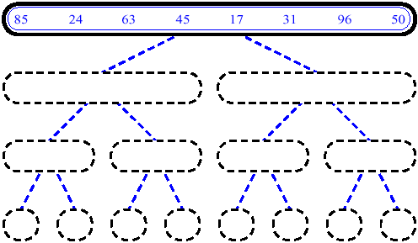
MergeSort (Example) - 1
Ravi Kant Sahu, Asst. Professor @ Lovely Professional University, Punjab (India)

Slide 12
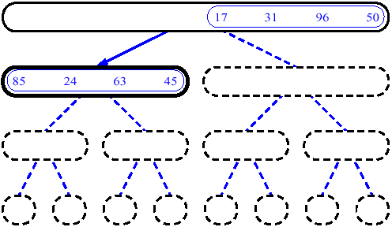
MergeSort (Example) - 2
Ravi Kant Sahu, Asst. Professor @ Lovely Professional University, Punjab (India)

Slide 13
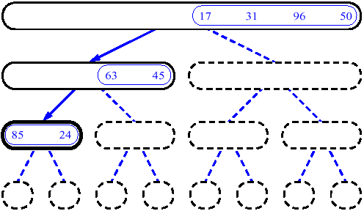
MergeSort (Example) - 3
Ravi Kant Sahu, Asst. Professor @ Lovely Professional University, Punjab (India)

Slide 14
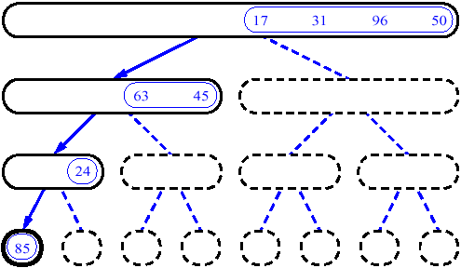
MergeSort (Example) - 4
Ravi Kant Sahu, Asst. Professor @ Lovely Professional University, Punjab (India)

Slide 15
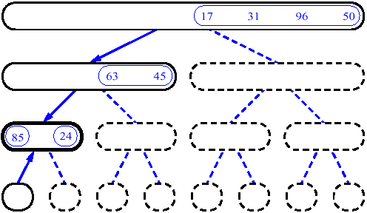
MergeSort (Example) - 5
Ravi Kant Sahu, Asst. Professor @ Lovely Professional University, Punjab (India)

Slide 16
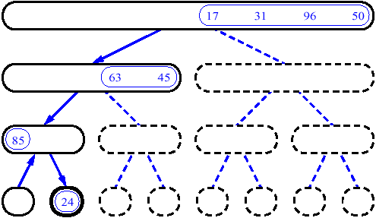
MergeSort (Example) - 6
Ravi Kant Sahu, Asst. Professor @ Lovely Professional University, Punjab (India)

Slide 17
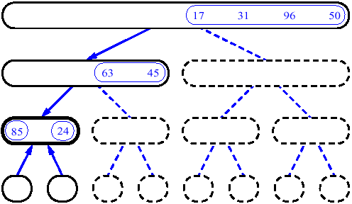
MergeSort (Example) - 7
Ravi Kant Sahu, Asst. Professor @ Lovely Professional University, Punjab (India)

Slide 18
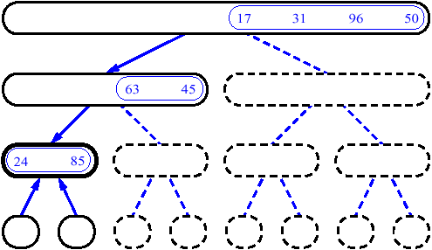
MergeSort (Example) - 8
Ravi Kant Sahu, Asst. Professor @ Lovely Professional University, Punjab (India)

Slide 19
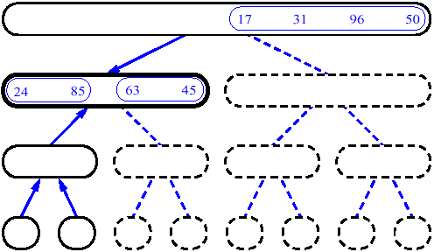
MergeSort (Example) - 9
Ravi Kant Sahu, Asst. Professor @ Lovely Professional University, Punjab (India)

Slide 20
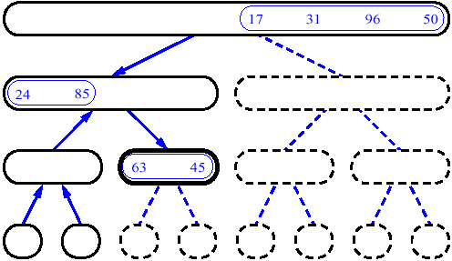
MergeSort (Example) - 10
Ravi Kant Sahu, Asst. Professor @ Lovely Professional University, Punjab (India)

Slide 21
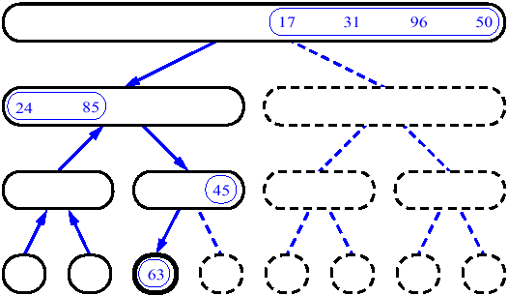
MergeSort (Example) - 11
Ravi Kant Sahu, Asst. Professor @ Lovely Professional University, Punjab (India)

Slide 22
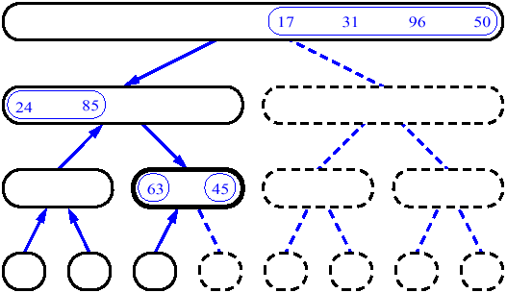
MergeSort (Example) - 12
Ravi Kant Sahu, Asst. Professor @ Lovely Professional University, Punjab (India)

Slide 23
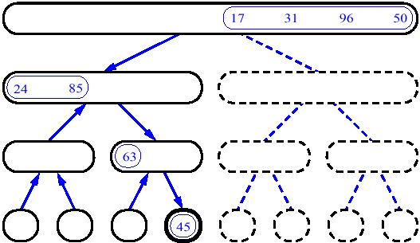
MergeSort (Example) - 13
Ravi Kant Sahu, Asst. Professor @ Lovely Professional University, Punjab (India)

Slide 24
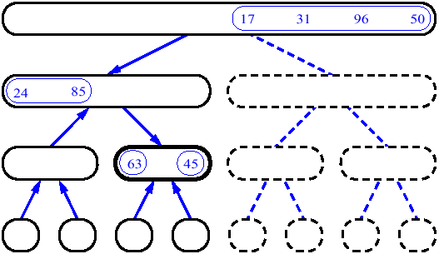
MergeSort (Example) - 14
Ravi Kant Sahu, Asst. Professor @ Lovely Professional University, Punjab (India)

Slide 25
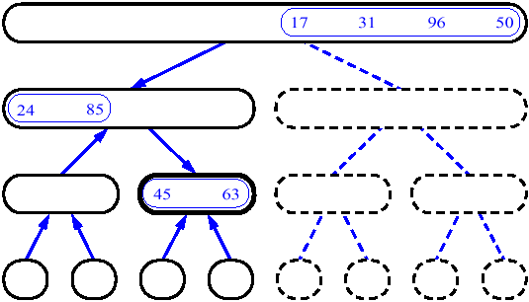
MergeSort (Example) - 15
Ravi Kant Sahu, Asst. Professor @ Lovely Professional University, Punjab (India)

Slide 26
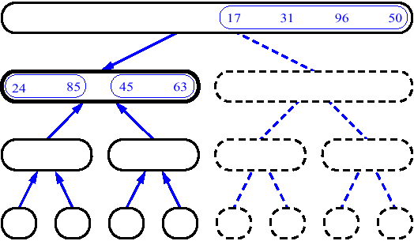
MergeSort (Example) - 16
Ravi Kant Sahu, Asst. Professor @ Lovely Professional University, Punjab (India)

Slide 27
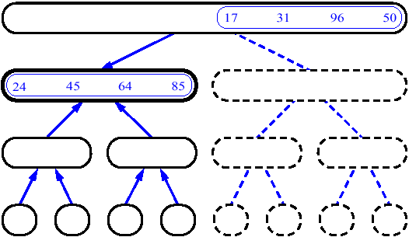
MergeSort (Example) - 17
Ravi Kant Sahu, Asst. Professor @ Lovely Professional University, Punjab (India)

Slide 28
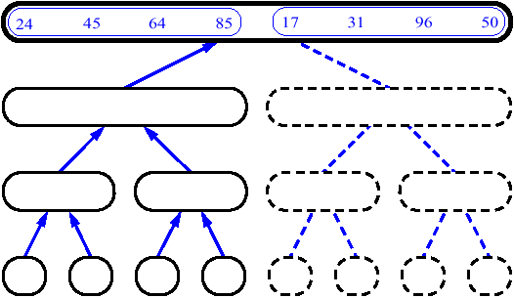
MergeSort (Example) - 18
Ravi Kant Sahu, Asst. Professor @ Lovely Professional University, Punjab (India)

Slide 29
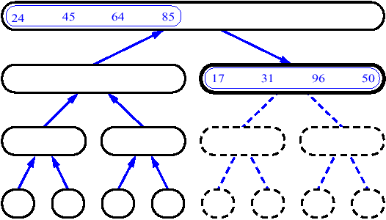
MergeSort (Example) - 19
Ravi Kant Sahu, Asst. Professor @ Lovely Professional University, Punjab (India)

Slide 30
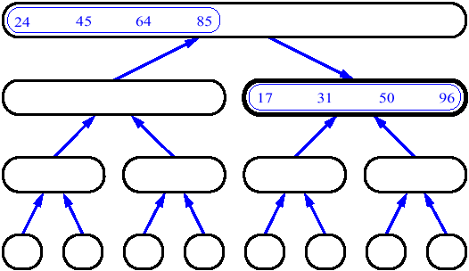
MergeSort (Example) - 20
Ravi Kant Sahu, Asst. Professor @ Lovely Professional University, Punjab (India)

Slide 31
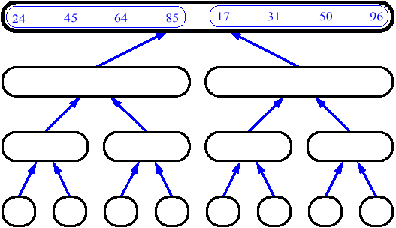
MergeSort (Example) - 21
Ravi Kant Sahu, Asst. Professor @ Lovely Professional University, Punjab (India)

Slide 32
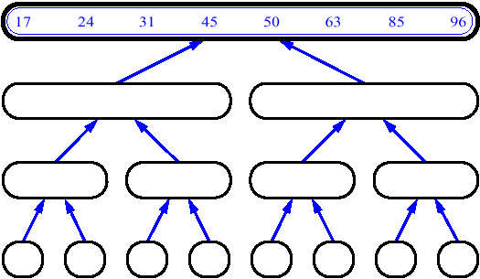
MergeSort (Example) - 22
Ravi Kant Sahu, Asst. Professor @ Lovely Professional University, Punjab (India)

Slide 33

Ravi Kant Sahu, Asst. Professor @ Lovely Professional University, Punjab (India)

